Slide 1

By - Samrudhi Jagtap
Pizza Sales Analysis
(SQL Project)

Slide 2

In this project, I analyzed pizza sales data to uncover key trends and insights that can help optimize business operations. The analysis involved writing SQL queries to:
Identify Best-Selling Pizzas: Determine which pizza types drive the most sales.
Analyze Sales Trends: Examine peak sales hours, days of the week, and seasonal trends.
Customer Preferences: Understand customer ordering behavior, including popular toppings and order sizes.
Location Performance: Compare sales across different locations to find top-performing outlets.
Operational Insights: Analyze data on delivery times and order volume to suggest improvements.
Skills Applied:
Advanced SQL queries
Data aggregation and filtering
Sales performance analysis
Customer behavior insights
This analysis provides valuable information for strategic decision-making and optimizing future sales performance.

Slide 3

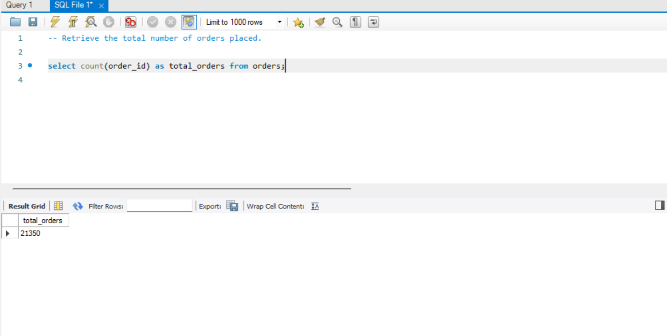

Slide 4
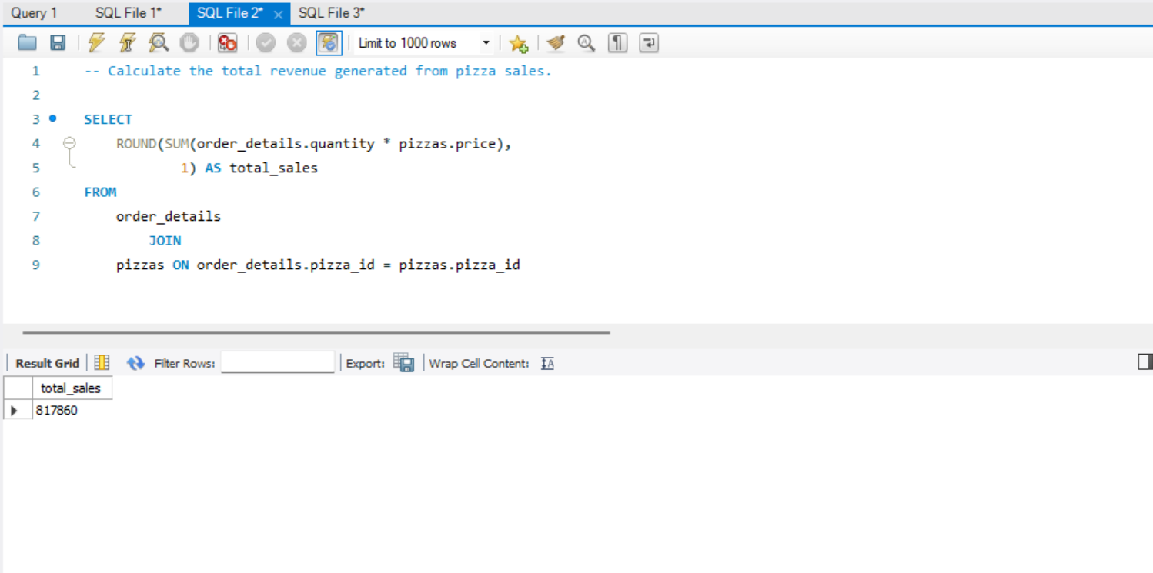

Slide 5
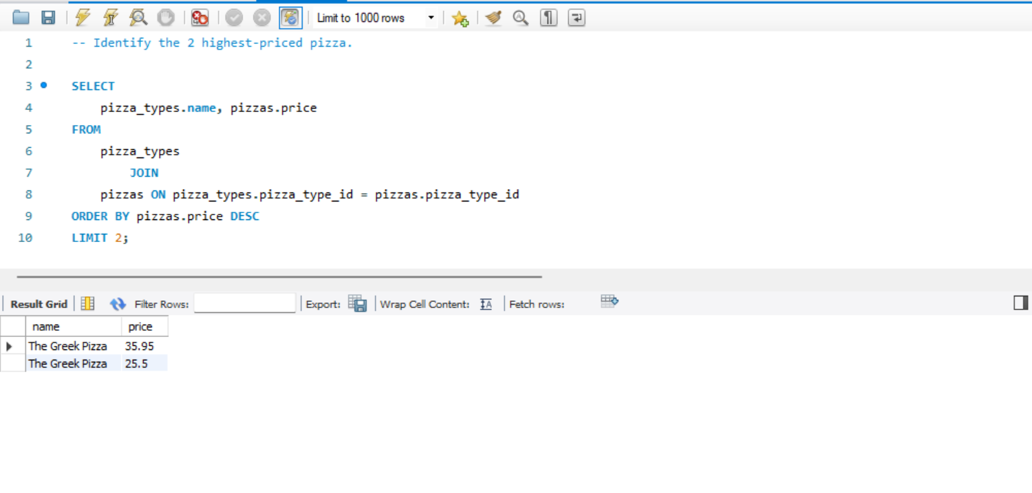

Slide 6
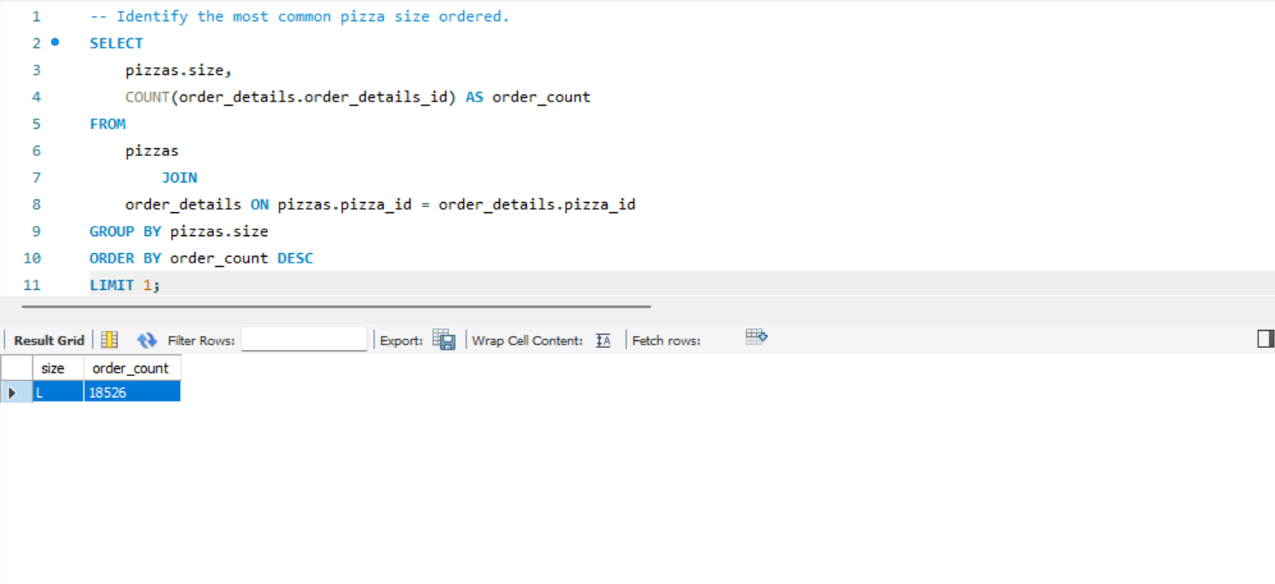

Slide 7
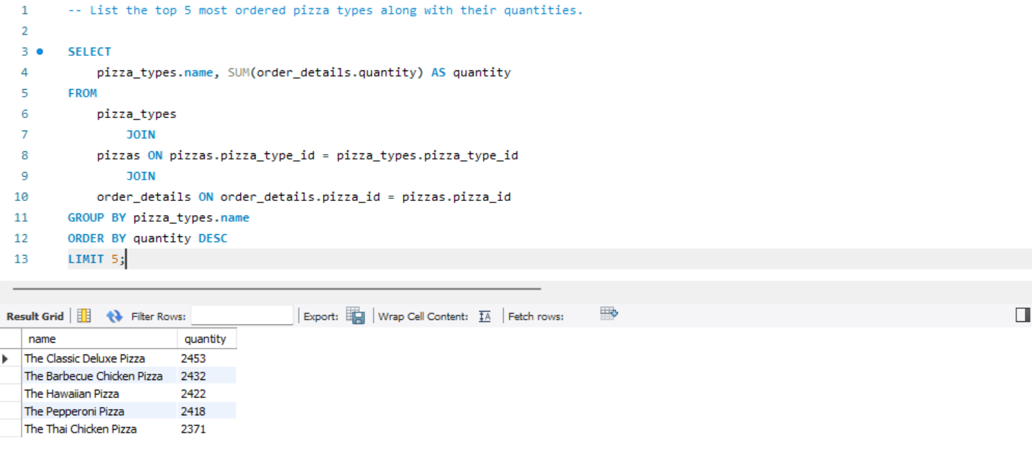

Slide 8
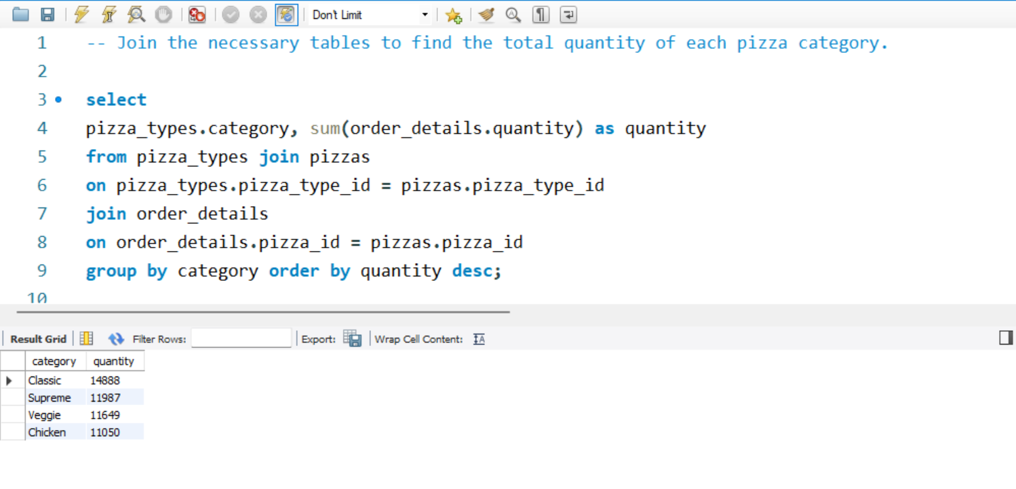

Slide 9
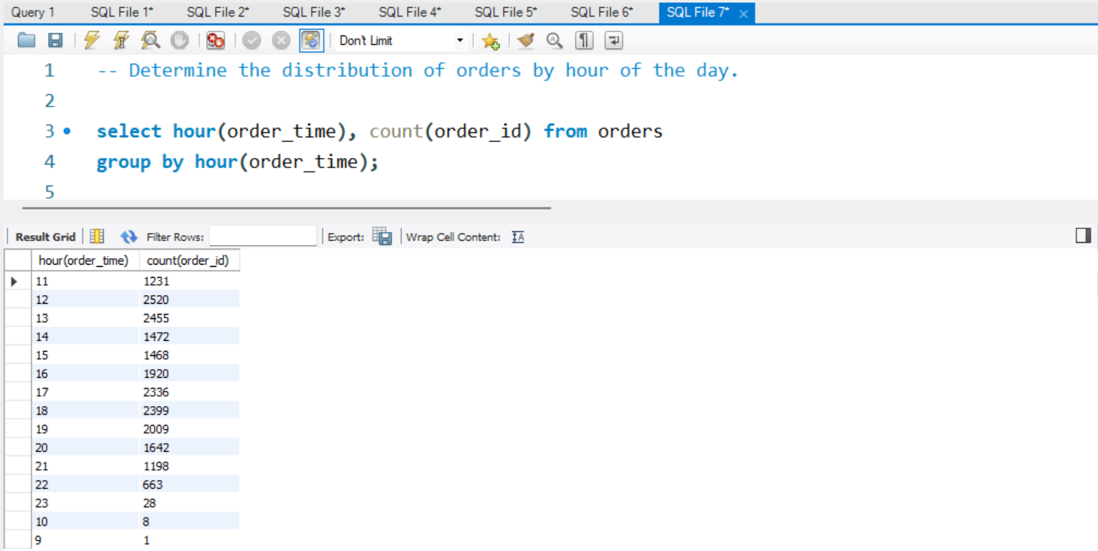

Slide 10
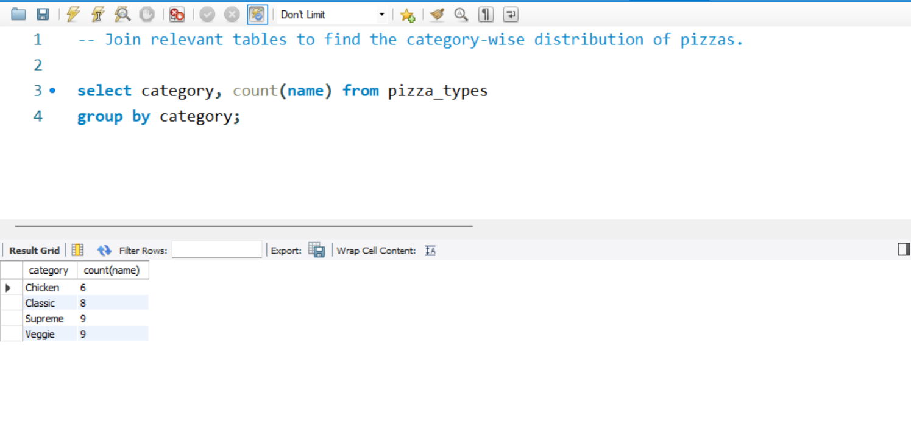

Slide 11
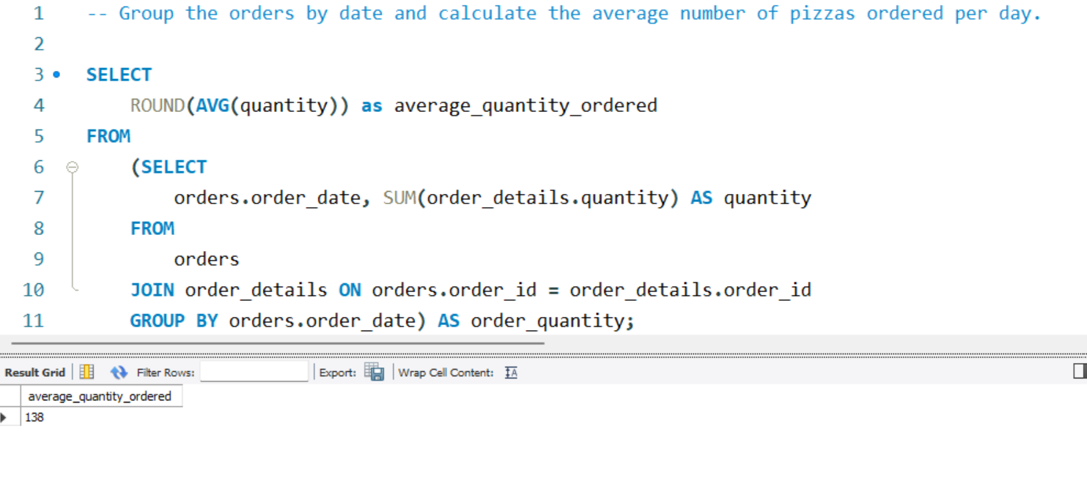

Slide 12
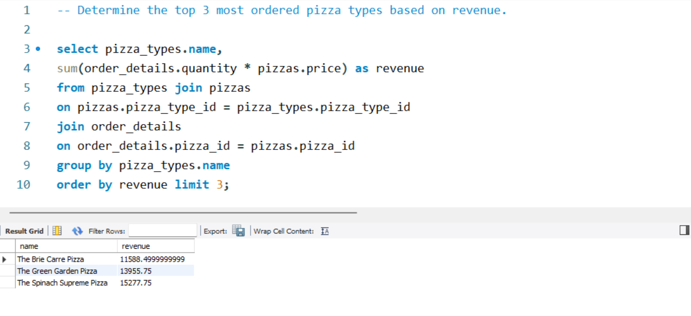

Slide 13
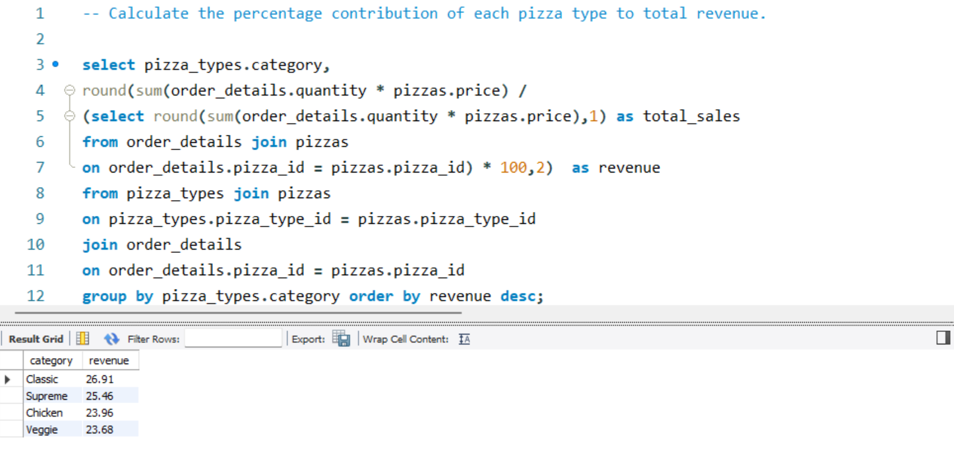

Slide 14
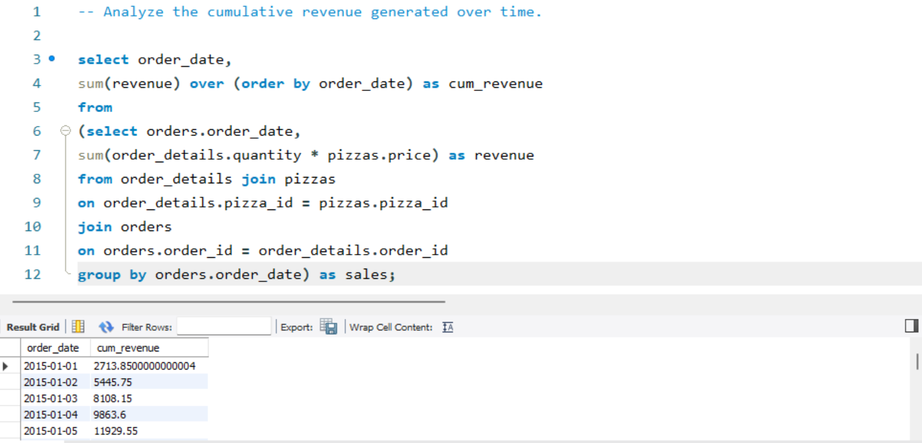

Slide 15
